Slide 1



Introduction to Testing
Presenter
Mohammad Anees Alam
Notes:
1

Slide 2





Topics for Today!
Importance & types of testing
Unit Testing Frameworks
choosing a testing Framework
Structure of unit tests
Practical activities
Notes:
2

Slide 3
Why Testing is Crucial in Software Development ?
Improves Code Maintainability
Enables Continuous Integration (CI/CD)
Ensures Code Reliability
Prevents Costly Failures
Enhances Security & Compliance
Encourages Better Code Design
Builds Confidence in Deployment
Notes:
3

Slide 4
Types of Testing
Unit Testing
Integration Testing
Regression Testing
  Checks individual functions or modules.
  Tests component interactions.
  Verifies existing functionality.
  Tools: Postman, TestContainers.
  Tool: Selenium.
  Tools: pytest, JUnit.
  DevOps Stage: Pre-deployment.
  DevOps Stage: Post-deployment.
  DevOps Stage: Pre-commit.
End-to-End Testing
Performance Testing
Security Testing
  Tests the entire application flow.
  Measures speed and scalability.
  Identifies vulnerabilities.
  Tool: Selenium for web automation.
  Tool: Load testing with JMeter.
  Tool: OWASP ZAP for penetration testing.
  DevOps Stage: Post-deployment (monitoring and tuning).
  DevOps Stage: Pre-deployment & Post-deployment.
  DevOps Stage: Pre-deployment & Continuous Monitoring.
Notes:
4

Slide 5



Bug hunts with testing !
Let's analyze how testing works with a simple use-case of finding bugs inside a basic app.
Clone the repository
Click here
Find the bug
Fix & Verify
Notes:
5

Slide 6

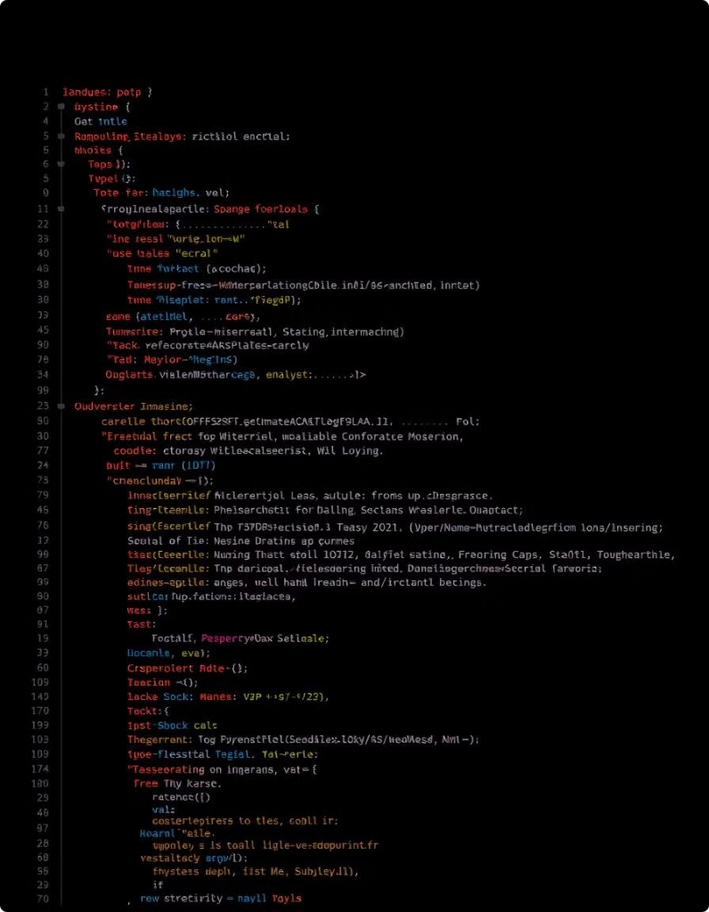



Unit Testing Frameworks
  Testing frameworks automate the execution of test cases, ensuring software reliability and catching bugs early in the development lifecycle.
  Different programming languages have different frameworks tailored to their needs.
pytest
JUnit
Jest
  Language: Python.
  Language: Java.
  Language: JavaScript.
  Best for: Startups, data science.
  Best for: Enterprise systems.
  Best for: React/Node.js apps.
  Key Feature: No boilerplate code needed.
  Key Feature: Strong IDE integration.
  Key Feature: Built-in code coverage.
Notes:
6

Slide 7





Automate - Bug hunts with testing !
Let's analyze how testing works with a simple use-case of finding bugs inside a basic app.
Set up a virtual environment
Create a new file with test_ format [test_bank.py] ​
Set the input values for your test cases
Run the testing framework [pytest or pytest -V]
Notes:
7

Slide 8

Real-World Scenarios:
Startup org: MVP
  Scenario: A small startup developing a web app using React & Node.js.
  Challenge: They need a quick, easy-to-set-up framework with good community support.
  Solution: Use Jest (fast setup, supports frontend & backend testing).
  Outcome: The startup quickly integrates Jest and releases the MVP on time.
Banking System Development
  Scenario: A financial institution developing a secure Java-based banking system.
  Challenge: They need strict type checking, unit tests, and integration tests to ensure security.
  Solution: Use JUnit with Mockito for effective testing and mocking.
  Outcome: The system passes security audits and is deployed without critical bugs.
Notes:
9

Slide 9
Writing Unit Tests: AAA Pattern
  When writing unit tests, following a structured approach ensures clarity.
  One of the most widely used testing patterns is AAA (Arrange, Act, Assert):
1
Arrange
2
Act
3
Assert
Set up the test data such as objects, variables, or mock data.
Execute the function under test.
Verify the expected outcome.
Sample:
Sample:
Sample:
result = user.get_profile() # Fetching the user profile
assert "Alice" in result # Ensure Alice's name appears in the profile
user = User(name="Alice") # Creating a user object
Pro Tips for Unit Tests:
1
Test Edge Cases
2
Avoid Testing Multiple Things in One Test Case
3
Make Tests Independent
4
Use Meaningful Test Names
Notes:
10

Slide 10
Hands-on Activity!
Implementing the AAA Pattern in Python (pytest)
1
Install pytest
2
Create user.py
3
Write a Unit Test (test_user.py)
4
Run the Test
5
Analyze the Output
6
Testing edge cases (optional)
Notes:
11

Slide 11



Practical : Testing a Banking System
1
Deposit
2
Withdraw
3
Balance
Steps to be followed:
1
2
3
Create/Clone the app
Write Unit Tests
Automating Unit Tests in CI/CD
Notes:
12

Slide 12




Assignment: To-Do List App
Task:
  To implement and test the To-Do List App using pytest, and then set up CI/CD automation using GitHub Actions.
Implement the To-Do List App
Set Up Your Project
Create a new directory and initialize the repository, then set up a venv with pytest packages.
1
2
Create todo.py file > Create test_todo.py file > Run the frameworks successfully using pytest -v.
Verify your build
Automate Tests
Push your commits and verify if changes are triggered for tests & built successful or not.
Add a trigger in your pipeline.(github Actions or jenkins)
4
3
Notes:
13

Slide 13
Learning Outcomes
Importance & Types of Testing
  Ensures software quality, reliability, and security.
  Covers Unit, Integration, Regression, Performance, Security, End-to-End testing.
Unit Testing Frameworks
  Automates function/module validation.
  Tools: pytest (Python), JUnit (Java), Jest (JavaScript), NUnit (C#).
Choosing a Testing Framework
  Based on language, project size, features required.
  Example: pytest for simplicity, JUnit for enterprise apps, Jest for frontend testing.
Structure of Unit Tests
  Follows AAA Pattern: Arrange, Act, Assert.
Final Thought: Testing is not just about finding bugs—it’s about preventing them!
Notes:
14

